Slide 1
From Biological Neurons to Artificial Neural Networks
James M. Irving, Ph.D.
Updated 10/30/20

Slide 2
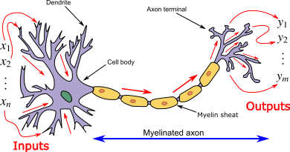
TOPICS TO COVER
Anatomy of a Neuron
How Neurons Process Info
Strengthening / Weakening Connections

Slide 3
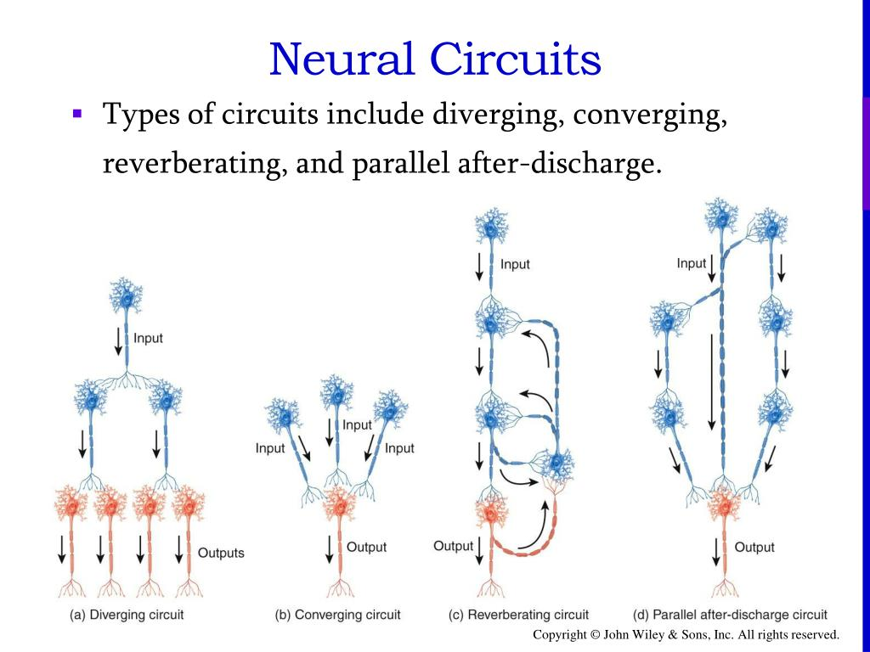
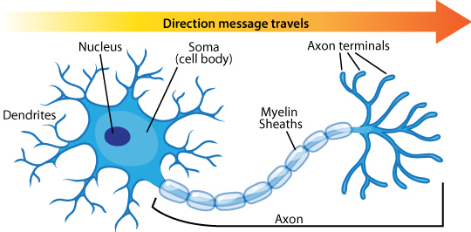
Anatomy of a Neuron I
Neurons are shaped kind of like a tree.
There are branches with leaves at the top (the dendrites/soma)
It has a long trunk (the axon)
The trunk ends with roots that connect to other neurons (the axon terminals)

Slide 4
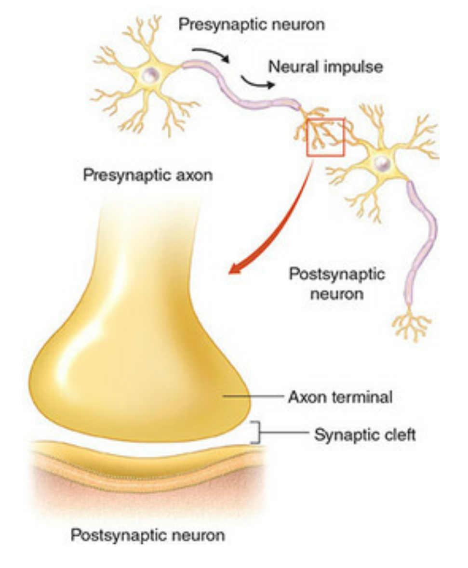
Anatomy of a Neuron II
Lots of neurons (hundreds-thousands) act as Inputs to the neuron by connecting to the neuron’s branches.
These are called “synapses”
Neurons released Neurotransmitters to send information across a synapse

Slide 5
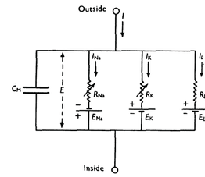
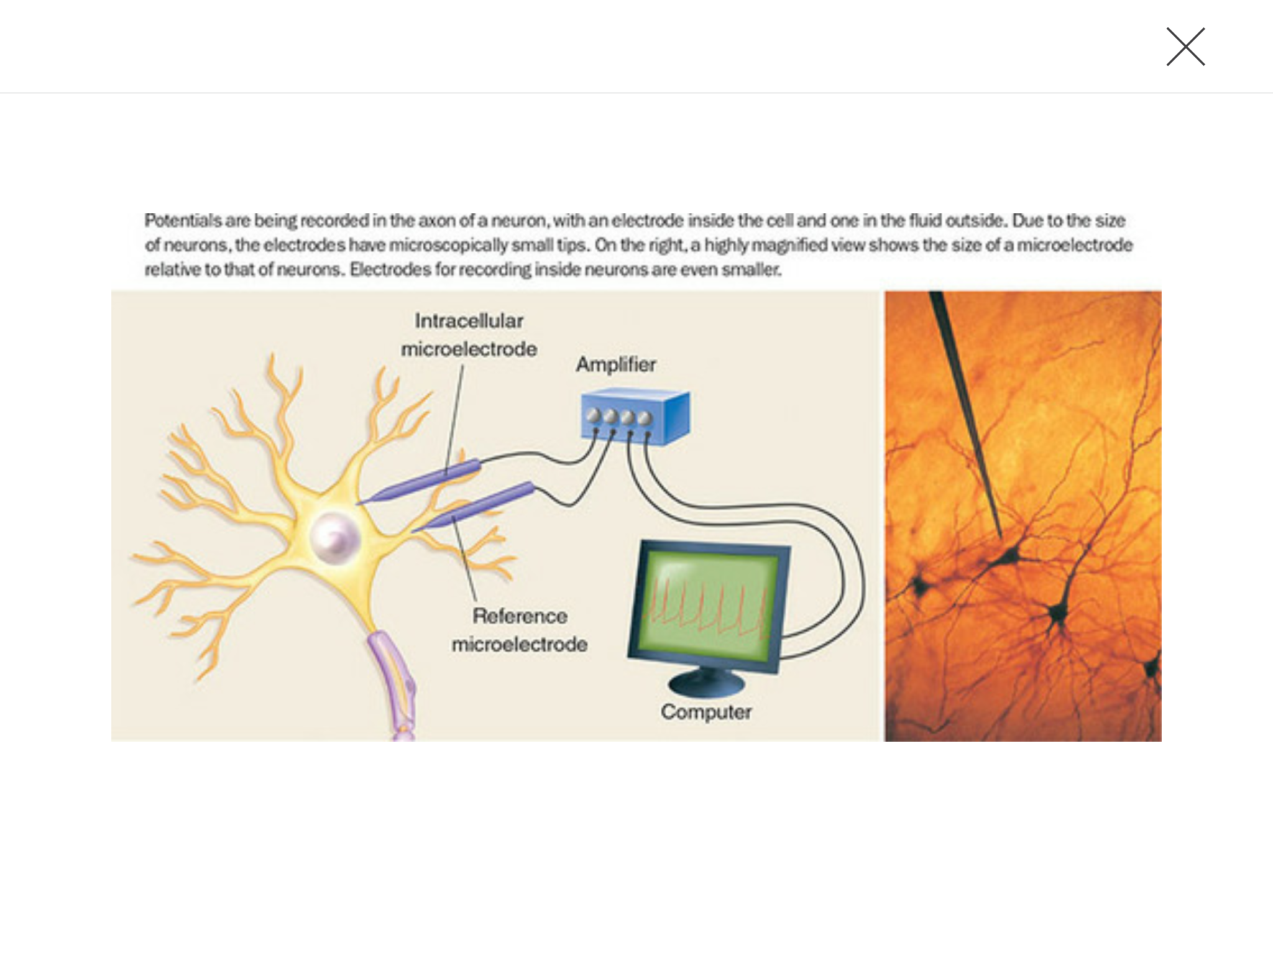
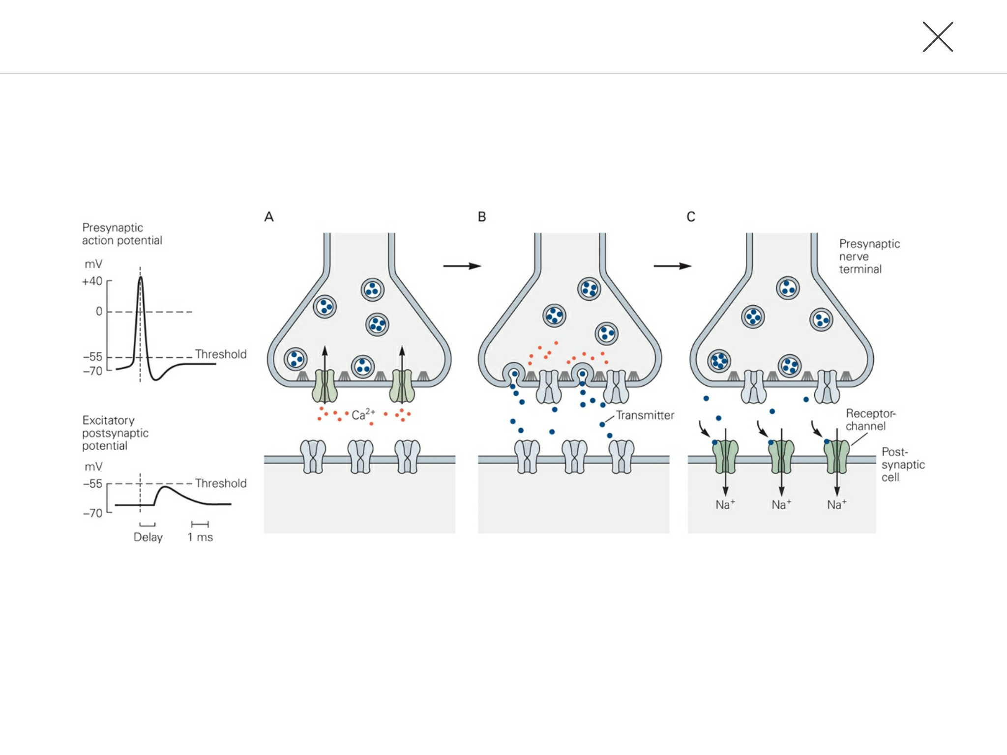
Neurons are Like Batteries
Neurons are like electrical circuits with batteries.
They have a certain resting voltage (~ -70mV).
Normally, neurons are NOT firing. They are waiting for input, sitting at a specific voltage.

Slide 6
How Neurons communicate
Neurotransmitters open special pores in the neuron that let in ions (electricity)
The change in electrical input will change the Voltage of the neuron.

Slide 7
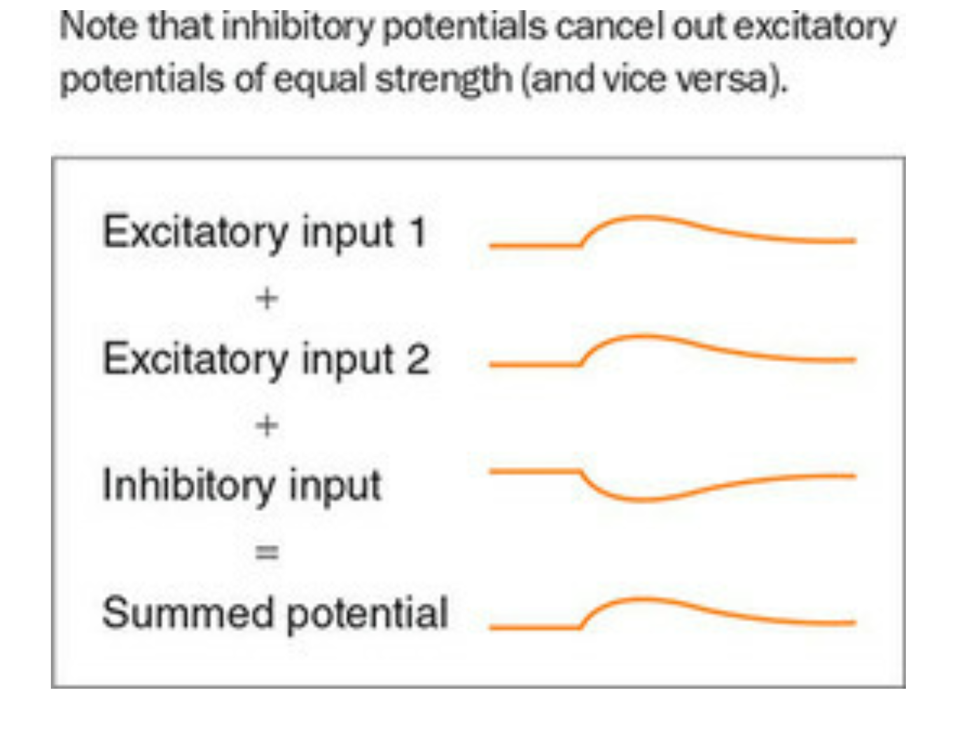
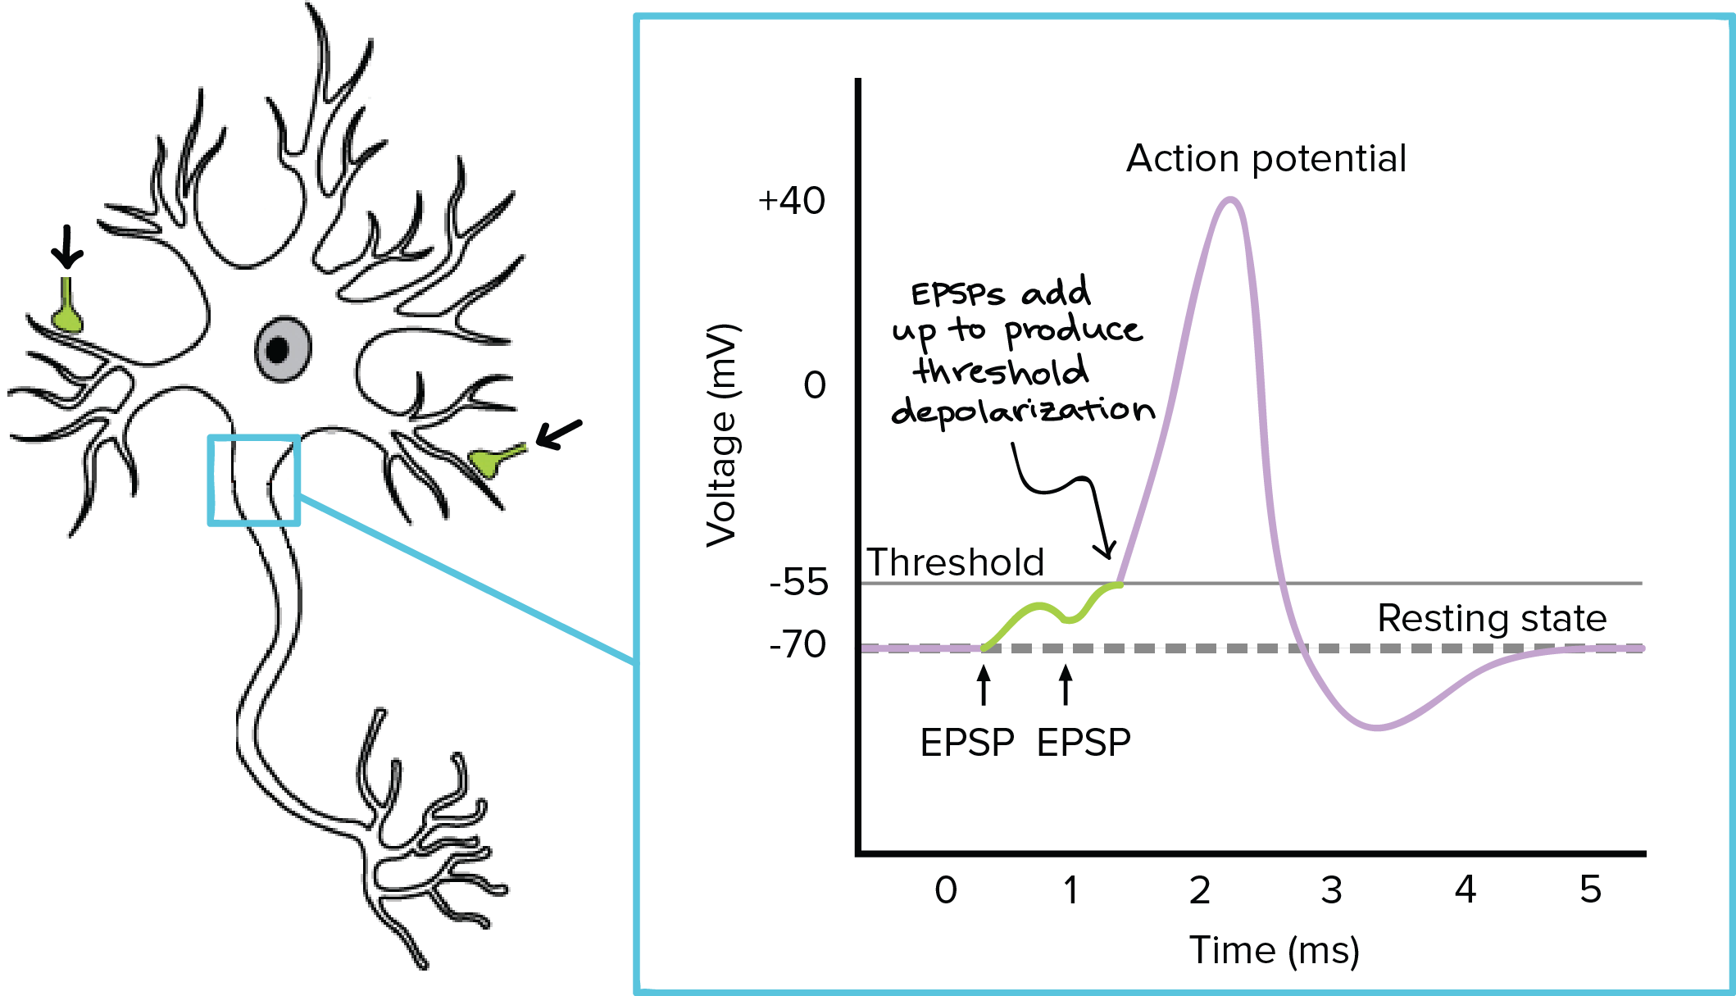
Neurons are Like Batteries
Some inputs decrease the neuron’s voltage (less likely to fire).
Some inputs increase the neuron’s voltage (more likely to fire).
If the SUMMED INPUT of all neurons is greater than the neuron’s threshold: the neuron fires.
After the neuron fires, it releases its own NTs onto the NEXT neurons.

Slide 8
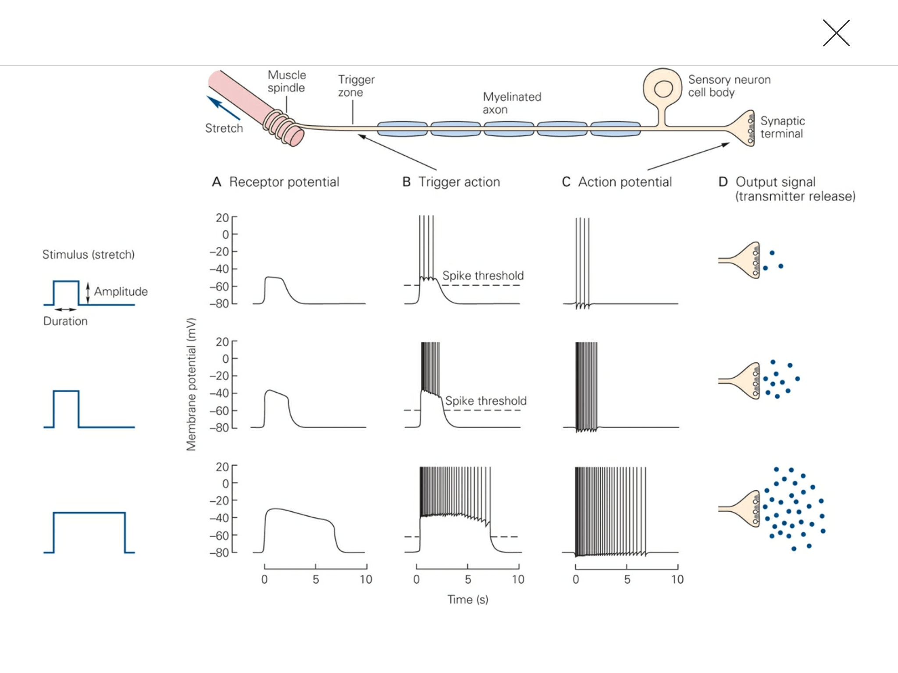
Example Information Processing
Information Traveling Through a Neuron to the next Neuron is called “forward propagation”
The more information/excitation a neuron receives, the more information/neurotransmitter it sends to the next neurons.

Slide 9
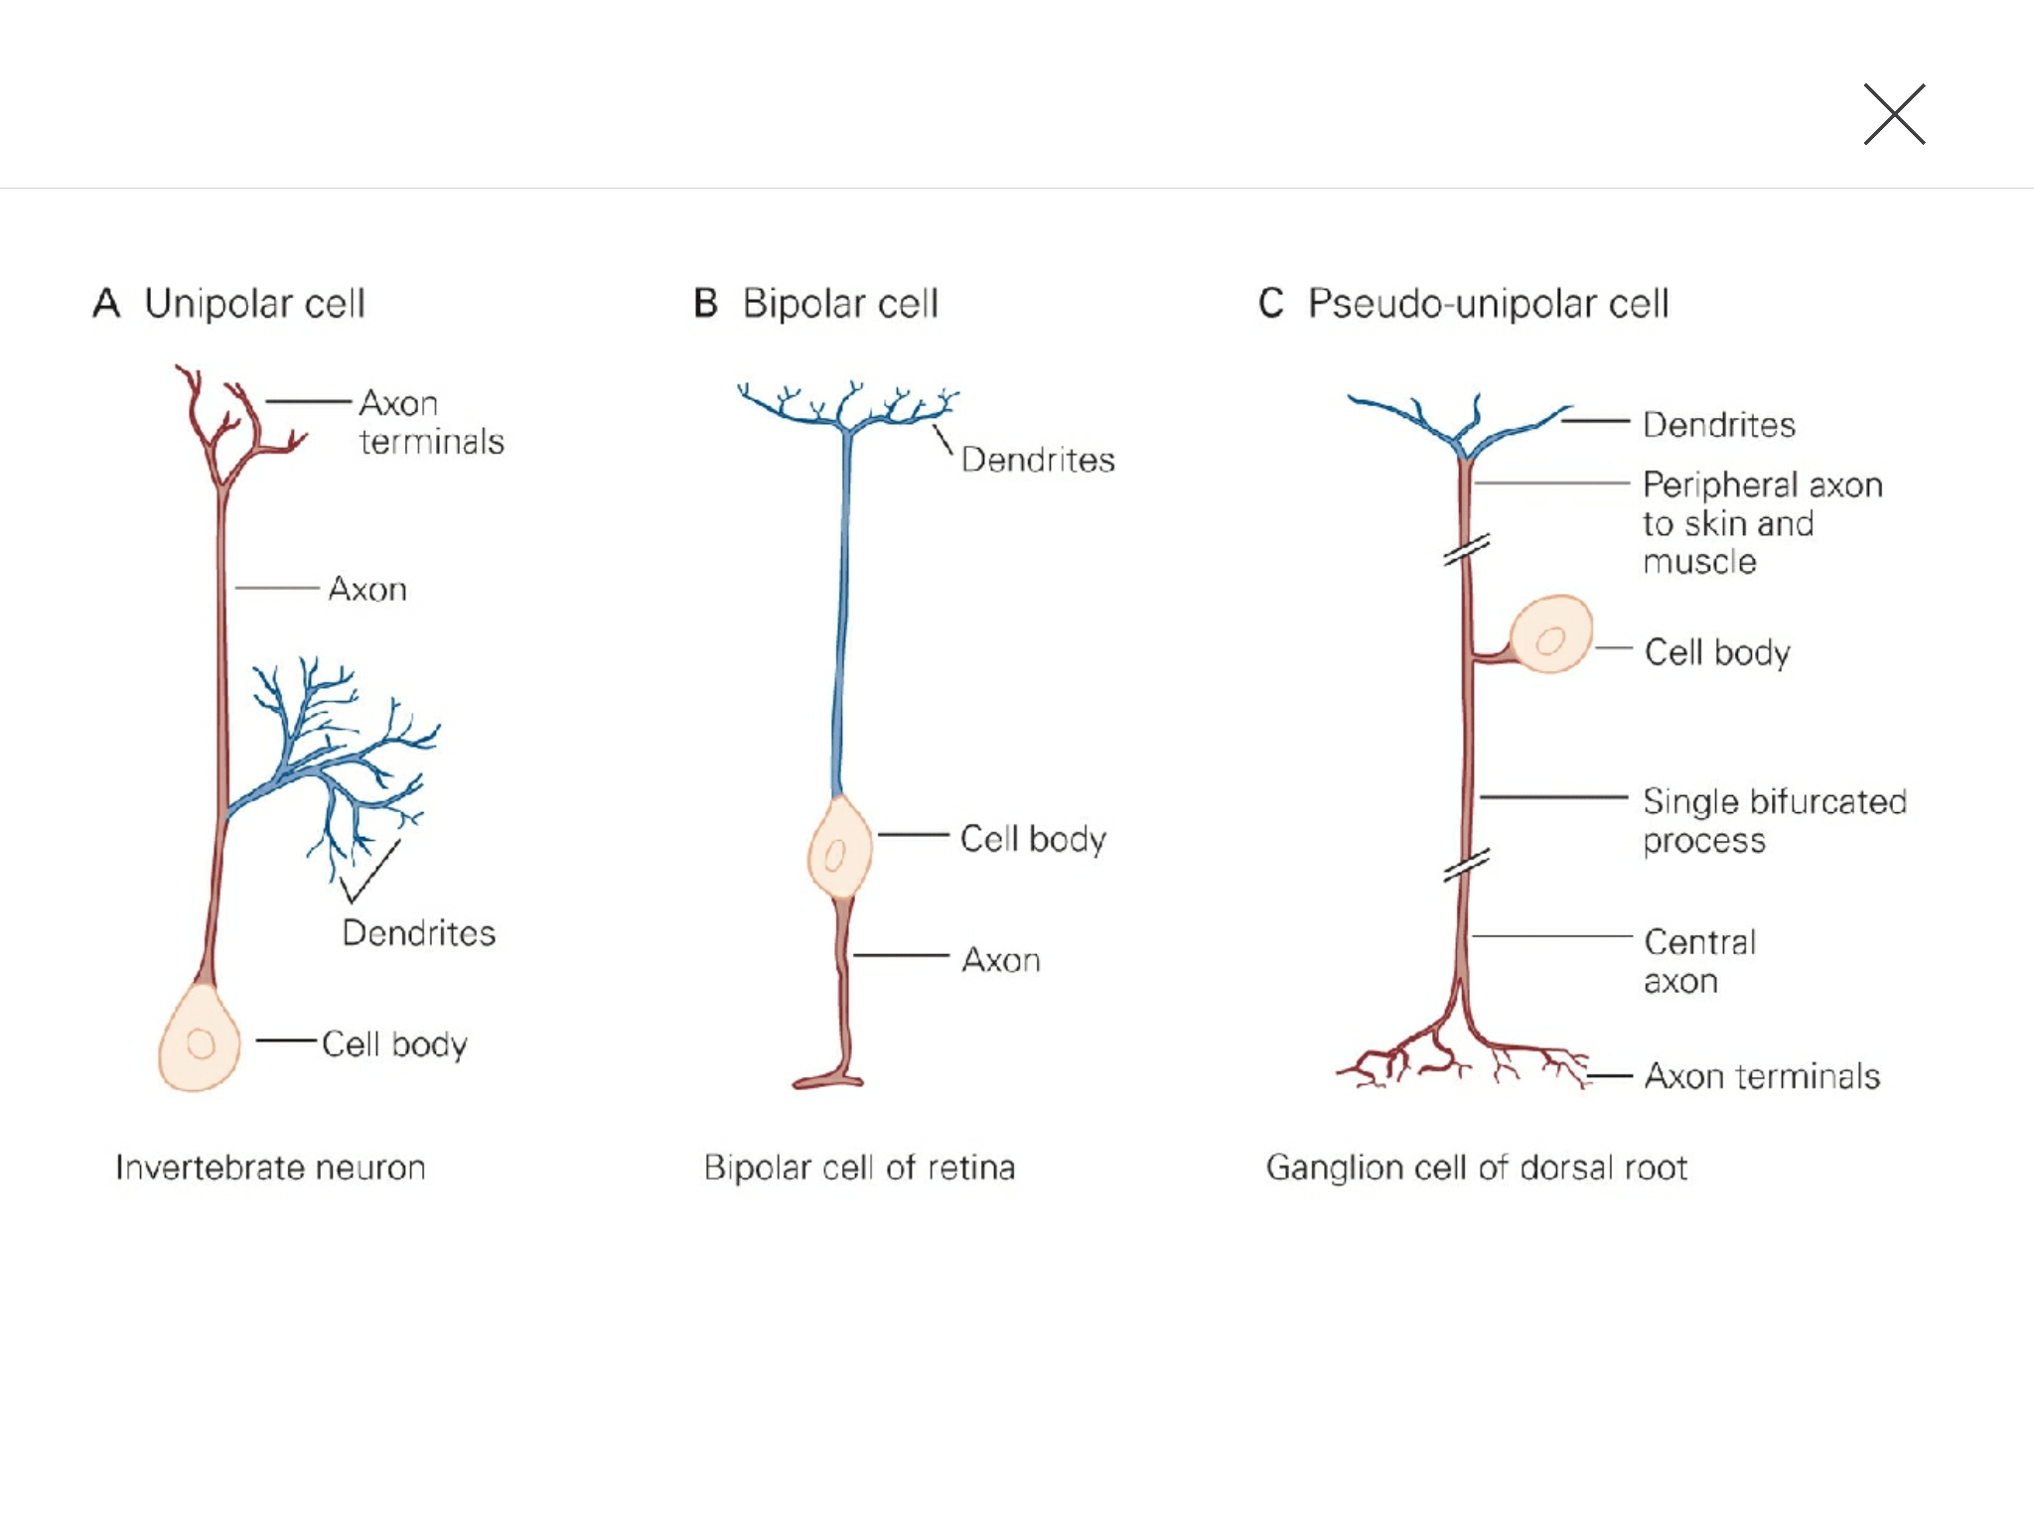
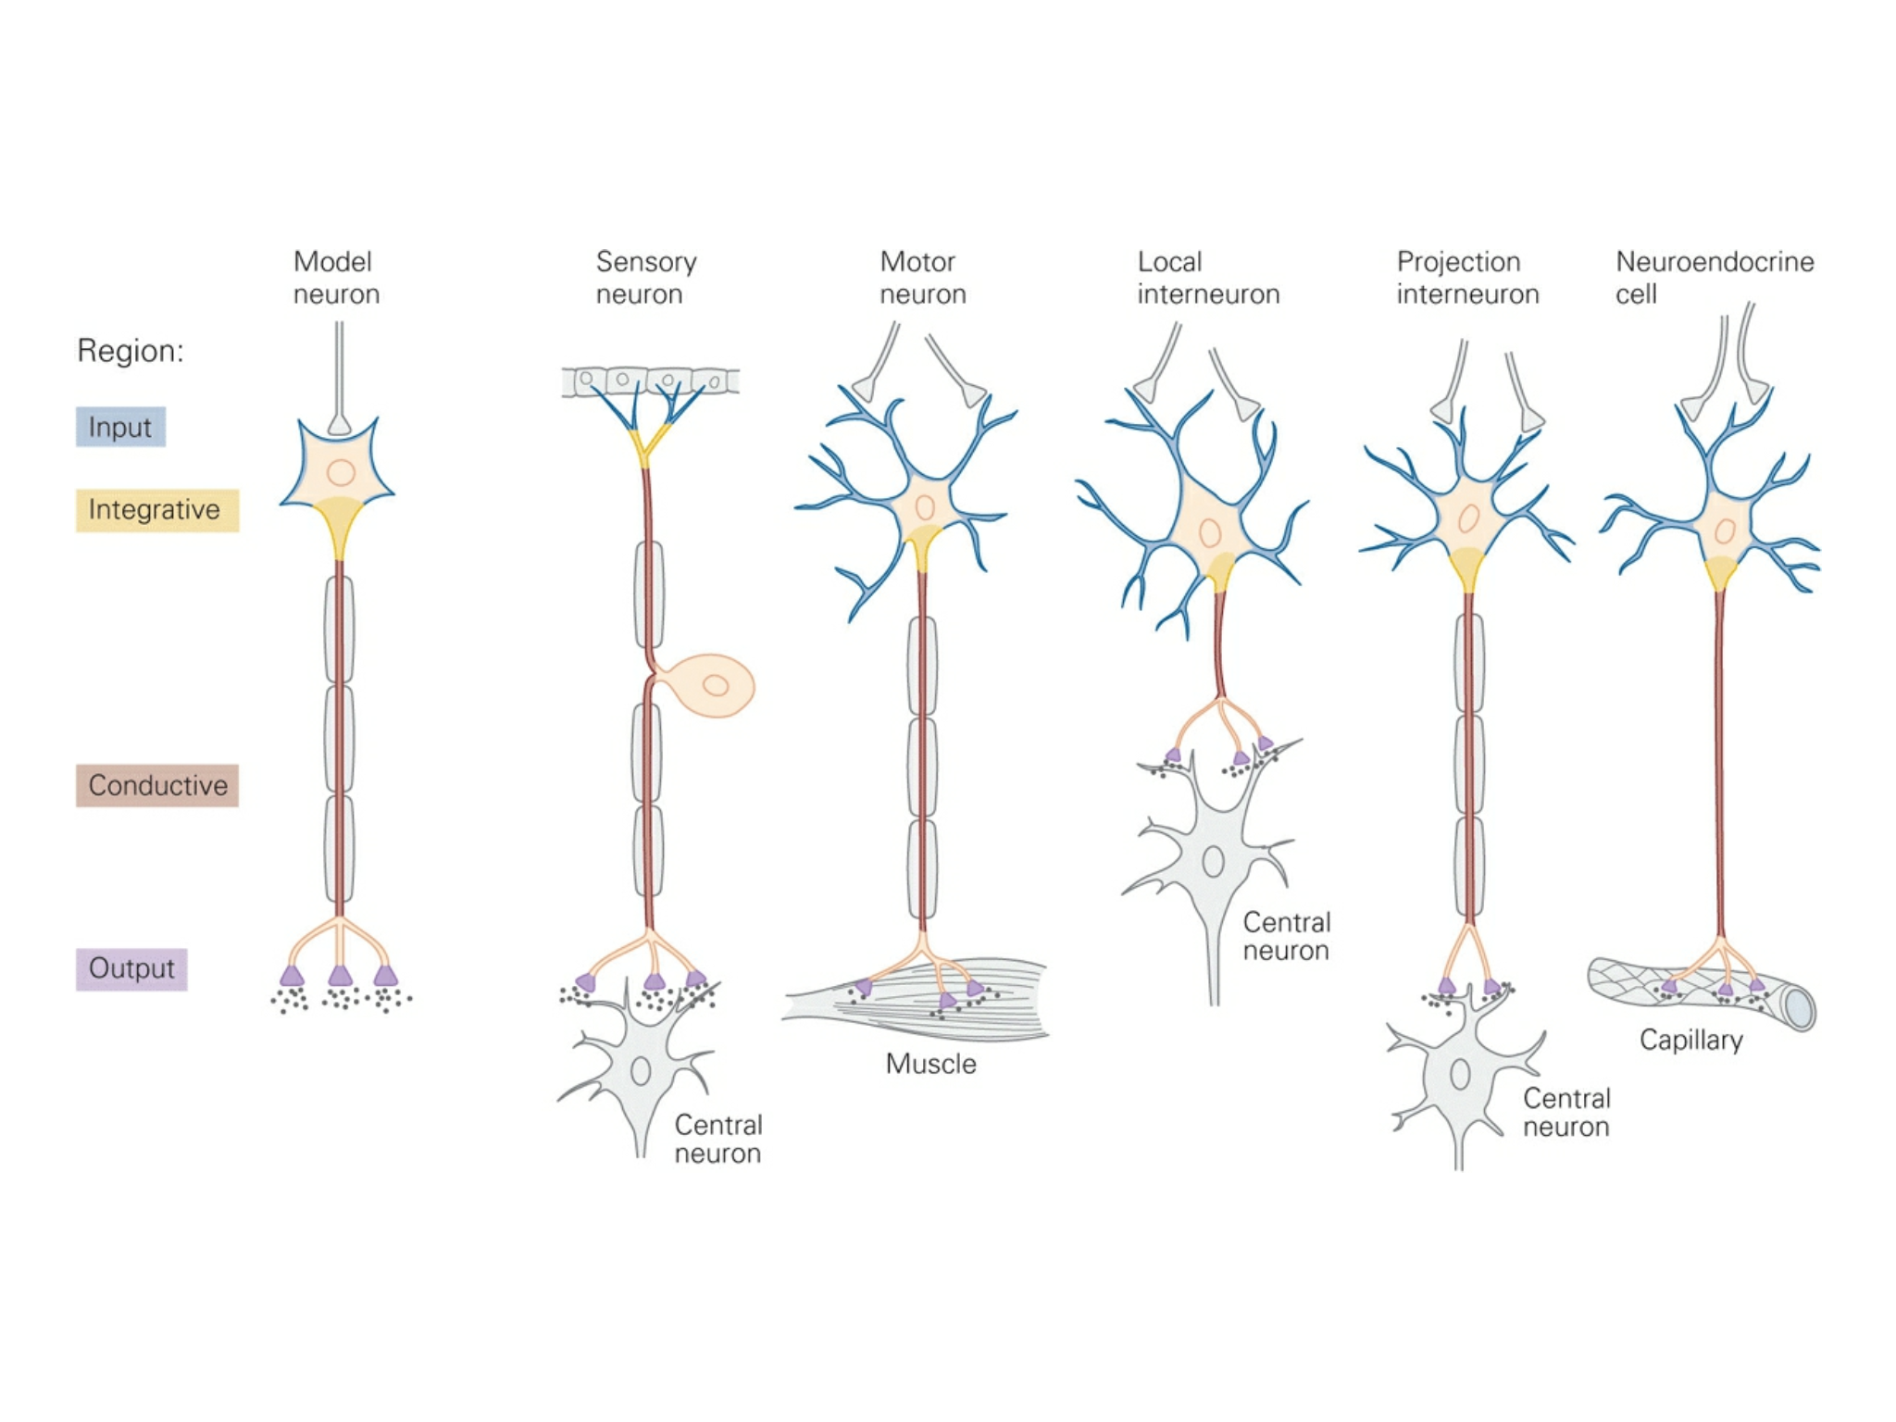
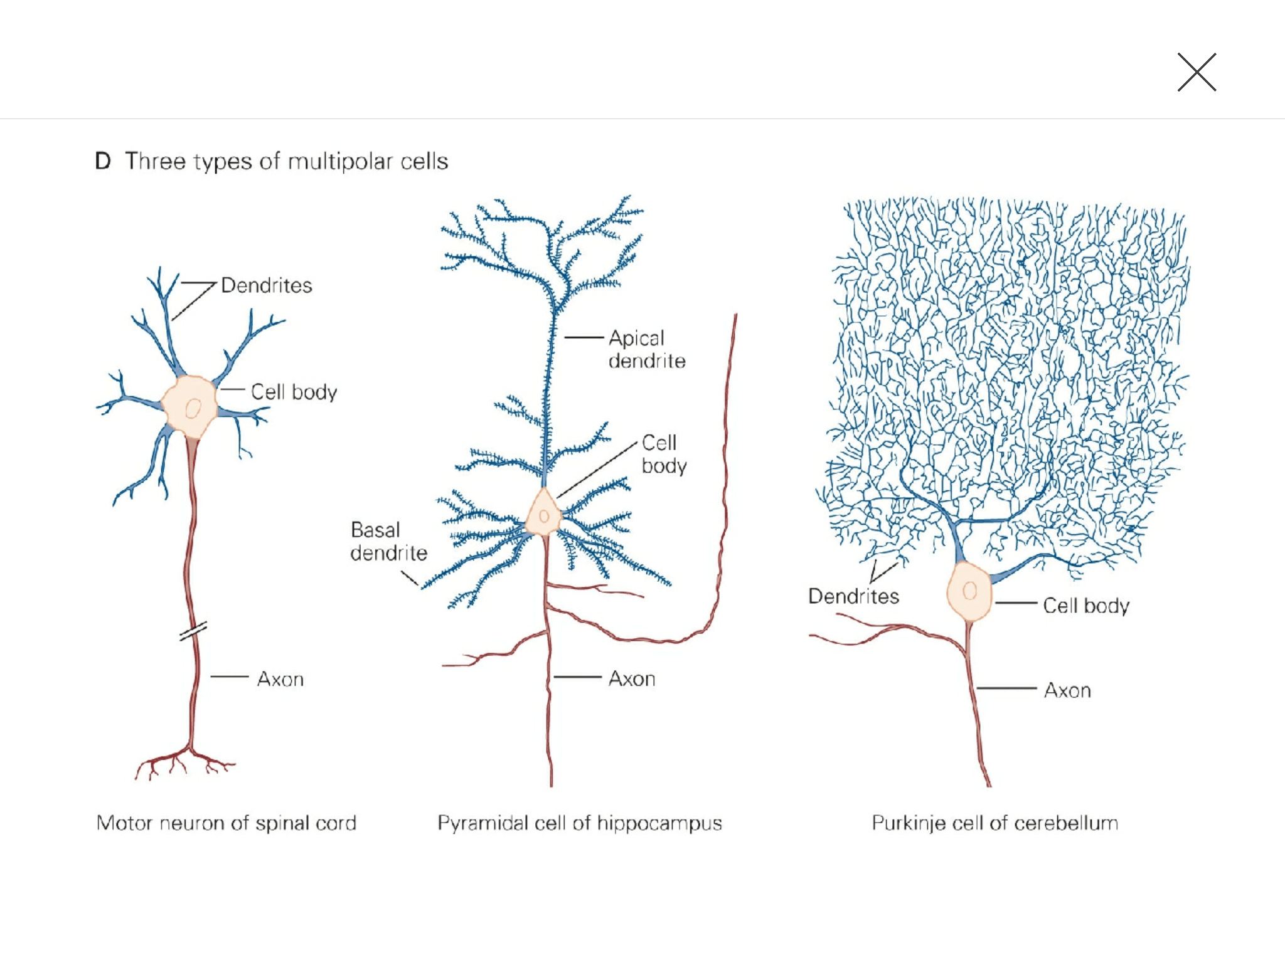
Many Types of Neurons
There are many types of neurons with different properties.
They have different resting voltages
They release different neurotransmitters
They affect other neurons in different ways.

Slide 10
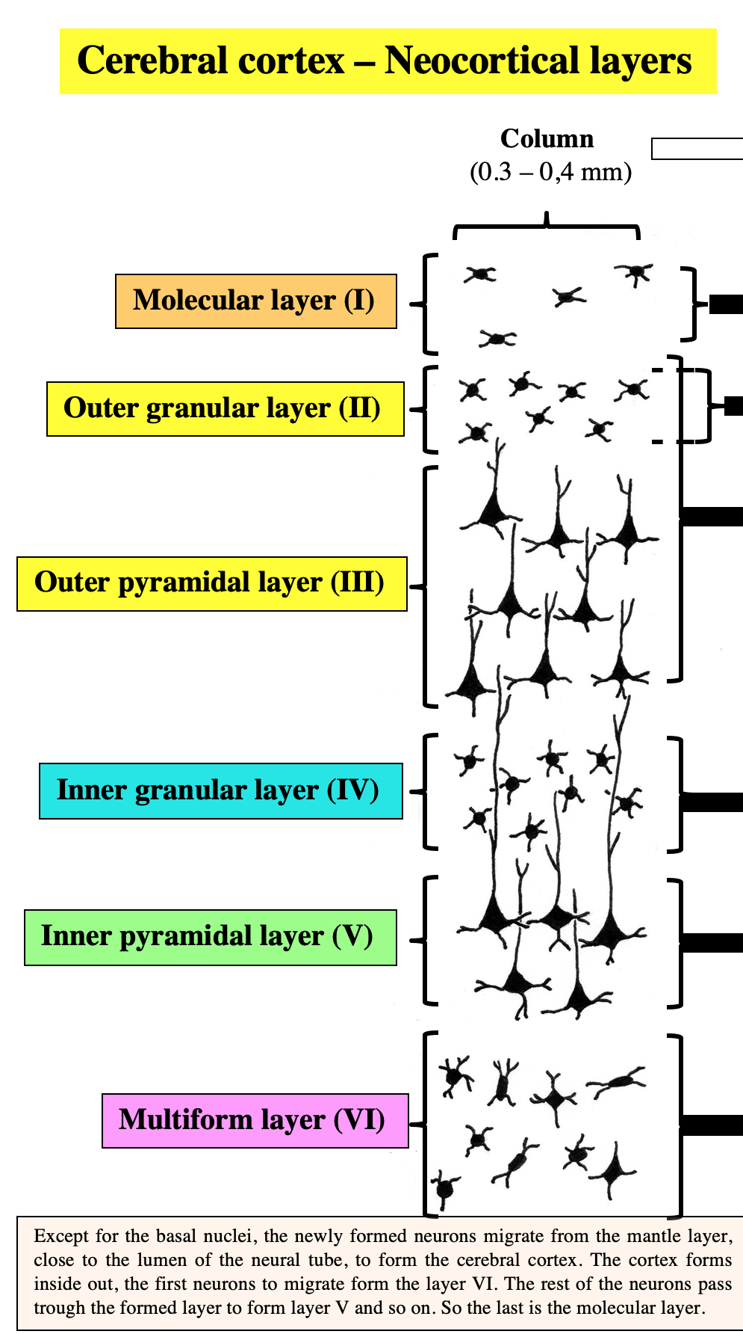
Neurons are Organized into Networks
Neurons are often arranged in a highly-organized multi-layered network
Information enters the network at specific layers
The information is processed and passed onto the next layer, and so on.

Slide 11
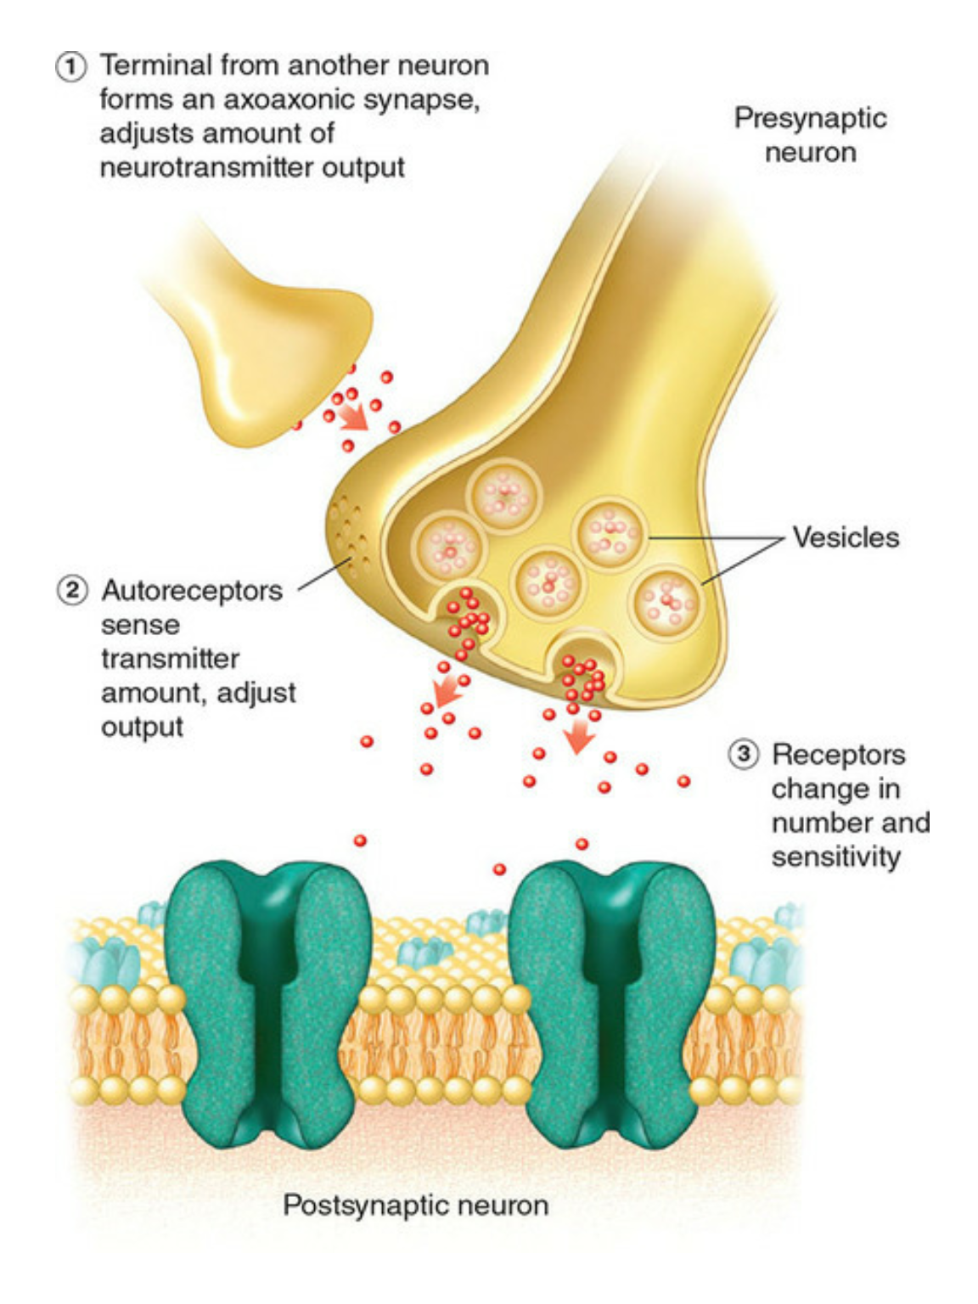
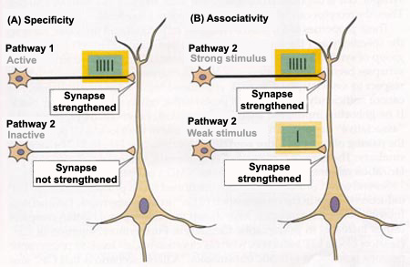
Strengthening of Connections
Neuroplasticity: “Cells that fire together wire together.”
Cells that interact strongly will make their connection stronger.

Slide 12
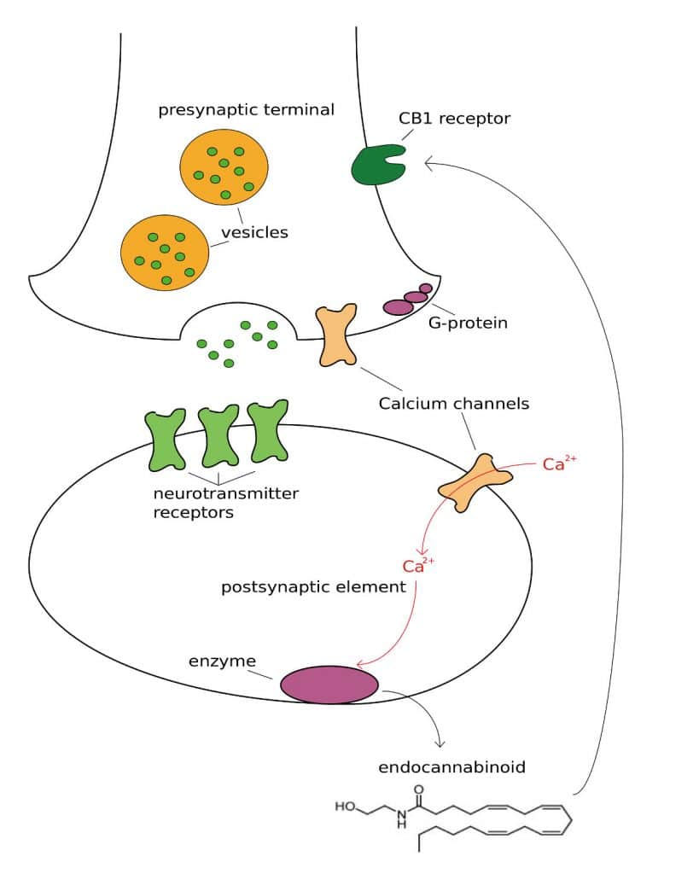
Weakening of Connections / Negative Feedback
Weakly/poorly activated neurons will weaken their connections

Slide 13
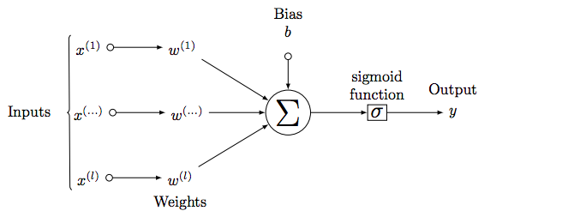
From Bio to Artificial
Artificial Neural Networks mimic the activity of bio neurons:
They take in lots of inputs from other neurons.
They sum up the input signal inside their cell bodies and then depending on the signal and then pass that message onto the next neurons.
The different properties of the cells (like activation functions) result in different information being shared.

Slide 14
Now Back to the Notebook…

